Slide 1

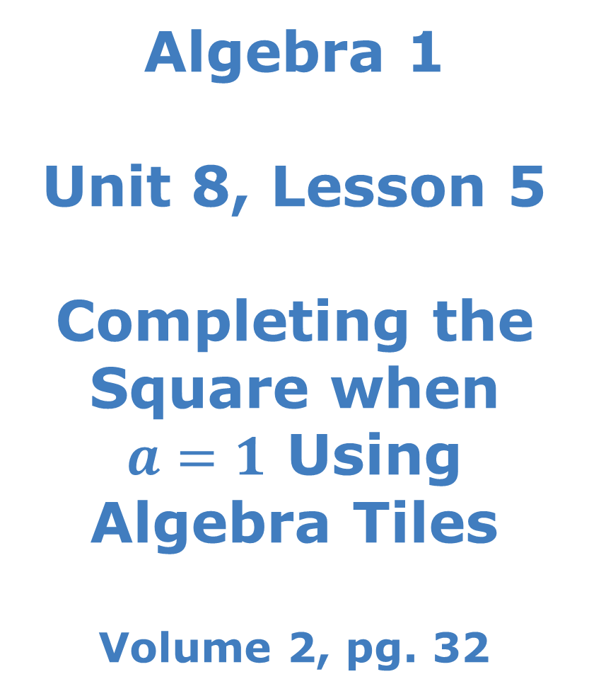
Algebra 1 Unit 8, Lesson 5 Completing the Square when $a=1$ Using Algebra Tiles Volume 2, pg. 32

Slide 2


Benchmarks
MA.912.AR.3.6
Given an expression or equation representing a quadratic function, determine the vertex and zeros and interpret them in terms of a real-world context.
MA.912.AR.1.2
Rearrange equations or formulas to isolate a quantity of interest.
volume 2, pg. 32

Slide 3
Integrated Mathematical Thinking and Reasoning Standards
MA.K12.MTR.2.1 Demonstrate understanding by representing problems in multiple ways.
MA.K12.MTR.3.1 Complete tasks with mathematical fluency.
MA.K12.MTR.4.1 Engage in discussions that reflect on the mathematical thinking of self and others.
MA.K12.MTR.5.1 Use patterns and structure to help understand and connect mathematical concepts.
MA.K12.MTR.6.1 Assess the reasonableness of solutions.
volume 2, pg. 32

Slide 4


Learning Target
I can use algebra tiles to complete the square for a quadratic expression where $a=1$.
volume 2, pg. 32

Slide 5

Warm-Up
volume 2, pg. 32

Slide 6
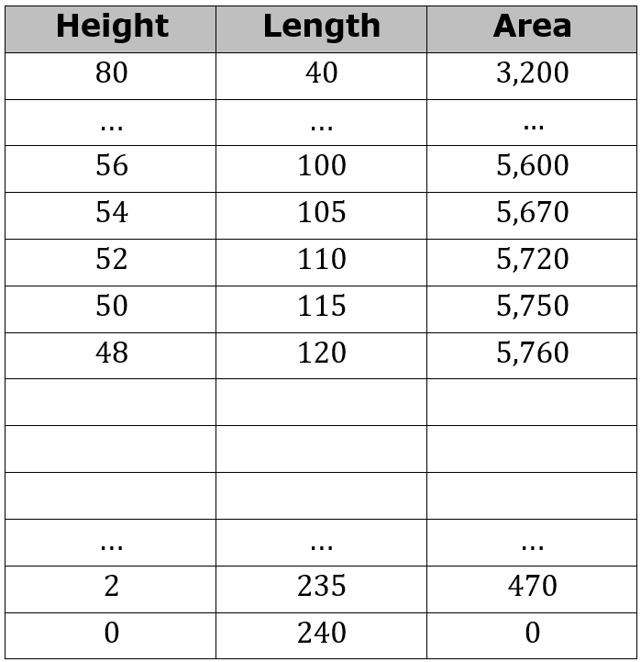
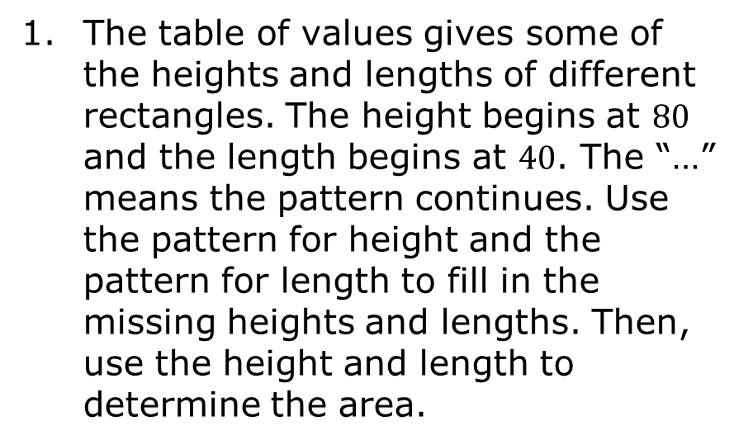
8.5.1 Warm-Up: Notice and Wonder
The table of values gives some of the heights and lengths of different rectangles. The height begins at $80$ and the length begins at $40$. The “…” means the pattern continues. Use the pattern for height and the pattern for length to fill in the missing heights and lengths. Then, use the height and length to determine the area.
volume 2, pg. 32

Slide 7
What do you notice about the patterns of each variable?
Height
Length
Area
volume 2, pg. 32

Slide 8

Exploration
volume 2, pg. 33

Slide 9

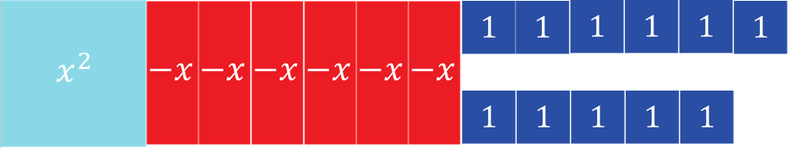
8.5.2 Exploration: Completing the Square Using Algebra Tiles
The algebra tiles shown represent the expression $x^{2}−6x+11.$
volume 2, pg. 33

Slide 10
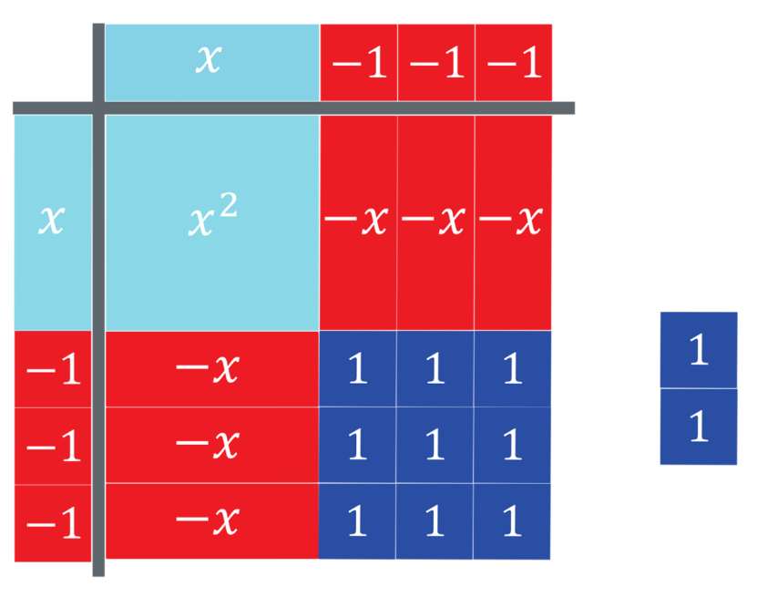
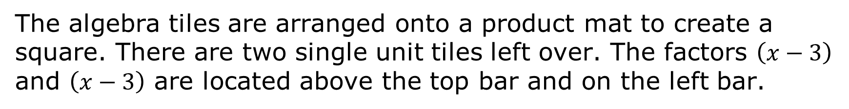
The algebra tiles are arranged onto a product mat to create a square. There are two single unit tiles left over. The factors $\left(x−3\right)$ and $\left(x−3\right)$ are located above the top bar and on the left bar.
volume 2, pg. 33

Slide 11

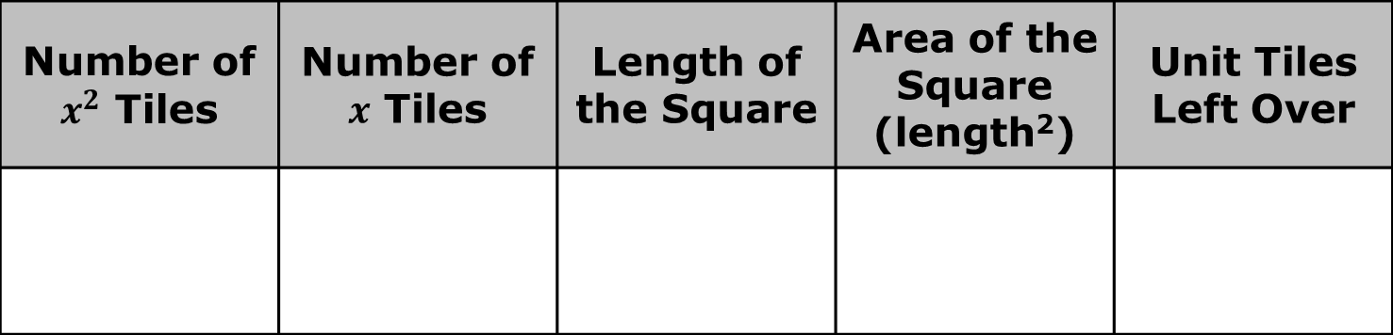
Use the algebra tiles on the product mat to complete the chart.
Number of $x^{2}$ Tiles | Number of $x$ Tiles | Length of the Square | Area of the Square (length²) | Unit Tiles Left Over
volume 2, pg. 33

Slide 12

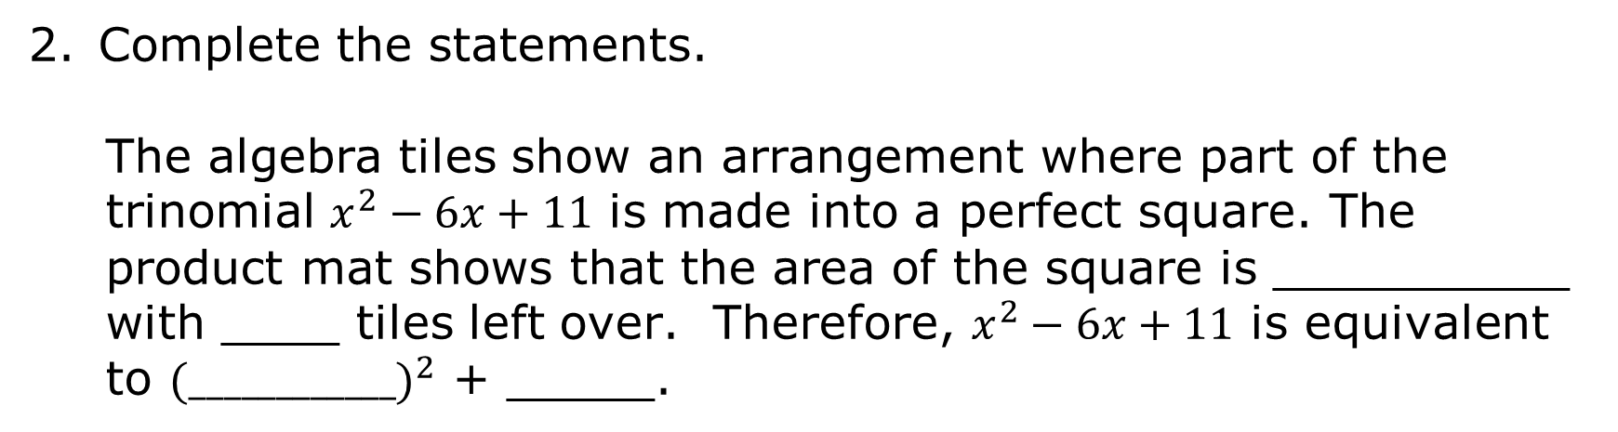
Complete the statements.
The algebra tiles show an arrangement where part of the trinomial $x^{2}−6x+11$ is made into a perfect square. The product mat shows that the area of the square is __________ with ____ tiles left over. Therefore, $x^{2}−6x+11$ is equivalent to ${(____________)}^{2}$ + _____.
This process is known as completing the square. It is used to rewrite a quadratic expression, equation, or function from standard form to vertex form.
volume 2, pg. 33

Slide 13
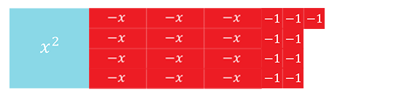
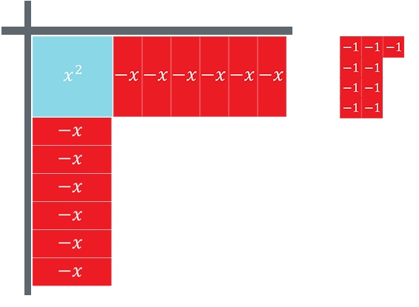
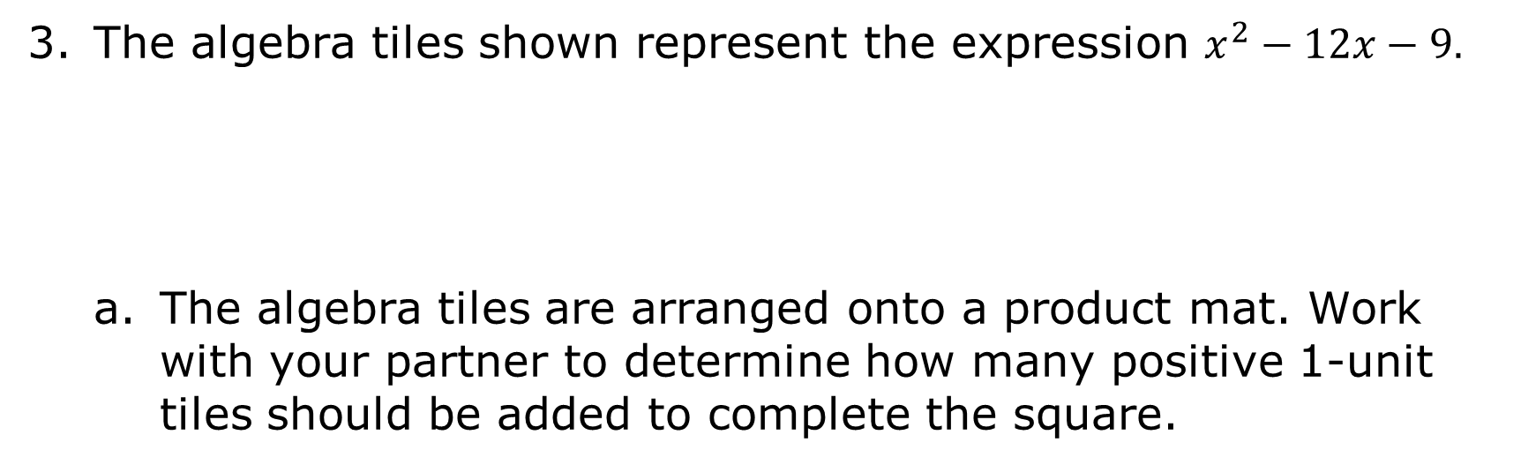
The algebra tiles shown represent the expression $x^{2}−12x−9.$
The algebra tiles are arranged onto a product mat. Work with your partner to determine how many positive 1-unit tiles should be added to complete the square.
volume 2, pg. 34

Slide 14


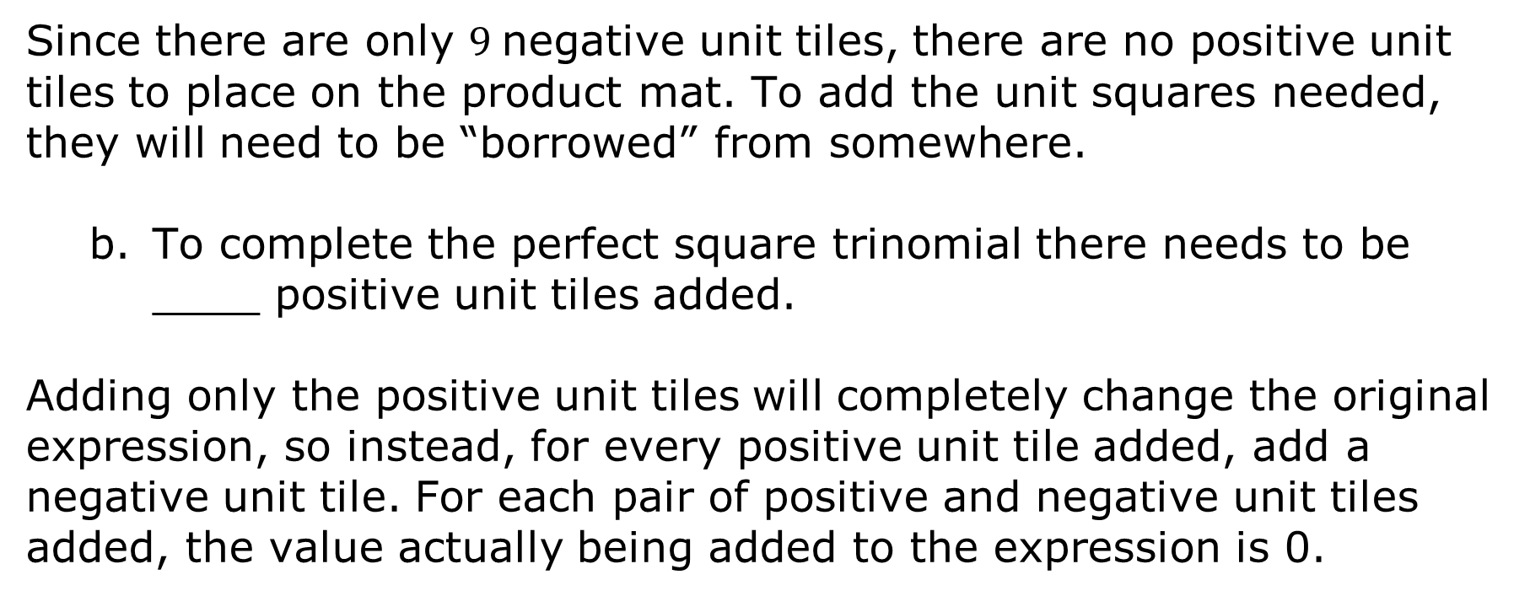
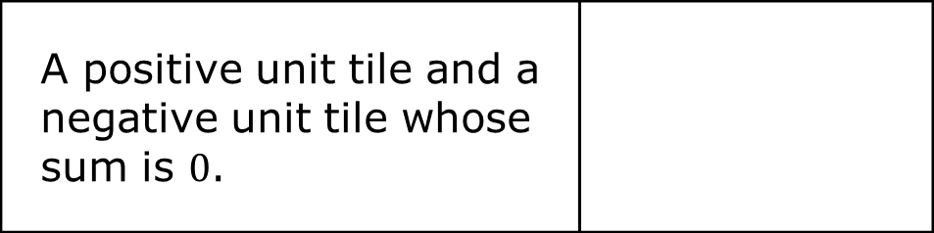
Since there are only $9$negative unit tiles, there are no positive unit tiles to place on the product mat. To add the unit squares needed, they will need to be “borrowed” from somewhere.
To complete the perfect square trinomial there needs to be ____ positive unit tiles added.
Adding only the positive unit tiles will completely change the original expression, so instead, for every positive unit tile added, add a negative unit tile. For each pair of positive and negative unit tiles added, the value actually being added to the expression is 0.
A positive unit tile and a negative unit tile whose sum is $0$.
volume 2, pg. 34

Slide 15
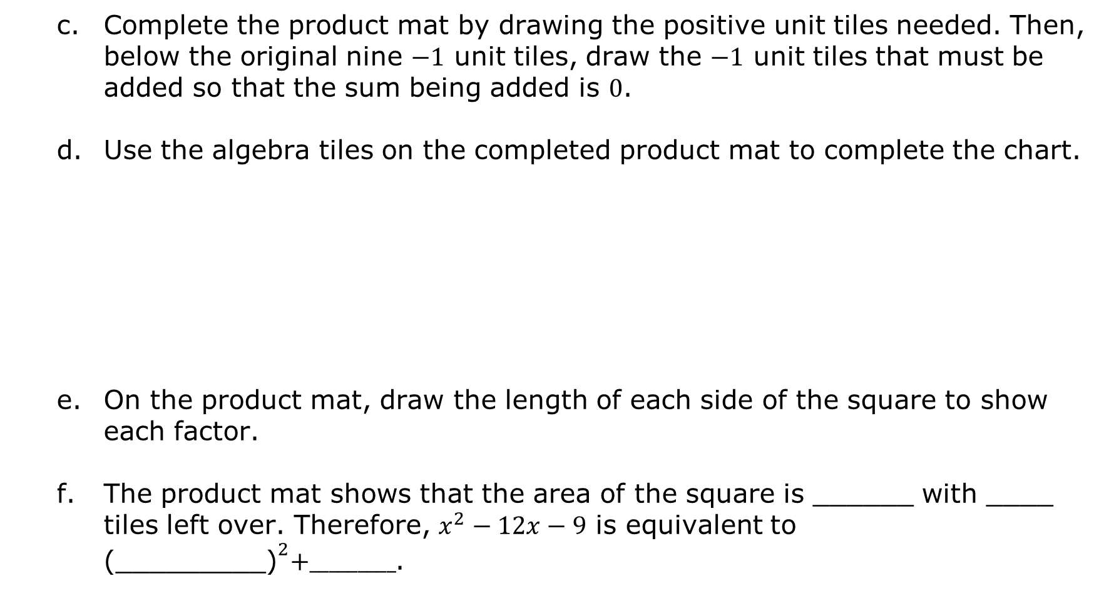
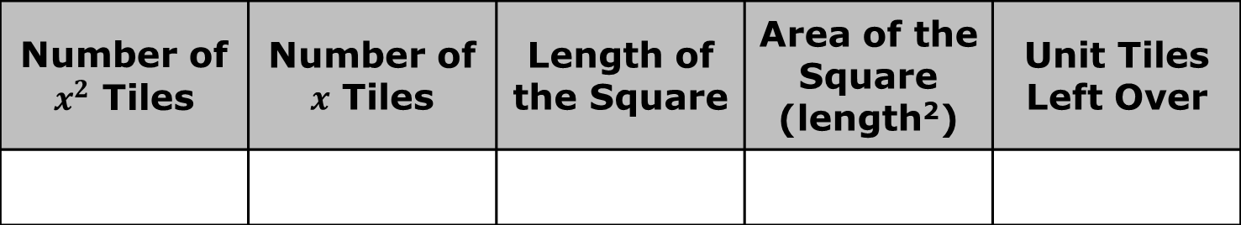
Complete the product mat by drawing the positive unit tiles needed. Then, below the original nine $−1$ unit tiles, draw the $−1$ unit tiles that must be added so that the sum being added is $0$.
Use the algebra tiles on the completed product mat to complete the chart.
On the product mat, draw the length of each side of the square to show each factor.
The product mat shows that the area of the square is ______ with ____ tiles left over. Therefore, $x^{2}−12x−9$ is equivalent to ${\text{(_________)}}^{2}+_________$.
Number of $x^{2}$ Tiles | Number of $x$ Tiles | Length of the Square | Area of the Square (length²) | Unit Tiles Left Over
volume 2, pg. 34

Slide 16
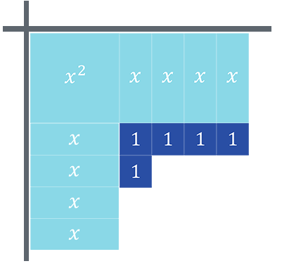

The algebra tiles on the product mat represent the expression $x^{2}+8x+5.$
How many positive unit tiles are needed to complete the square?
volume 2, pg. 35

Slide 17
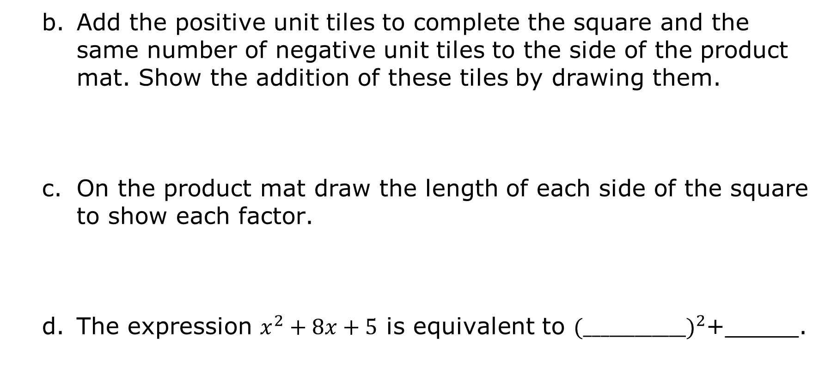
Add the positive unit tiles to complete the square and the same number of negative unit tiles to the side of the product mat. Show the addition of these tiles by drawing them.
On the product mat draw the length of each side of the square to show each factor.
The expression $x^{2}+8x+5$ is equivalent to ${(____________)}^{2}$+_____.
volume 2, pg. 35

Slide 18
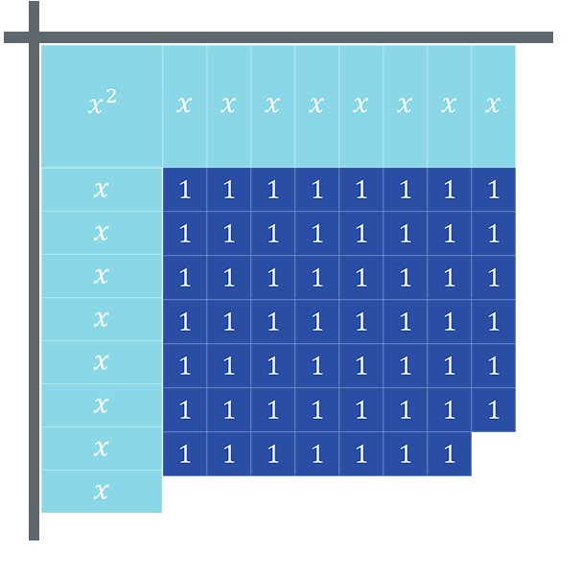

The algebra tiles on the product mat represent the expression $x^{2}+16x+55.$
On the product mat, complete the square and draw the length of each square to show each factor.
The expression $x^{2}+16x+55$ is equivalent to ${(____________)}^{2}$+ _____.
volume 2, pg. 35

Slide 19

Collaboration
volume 2, pg. 36

Slide 20

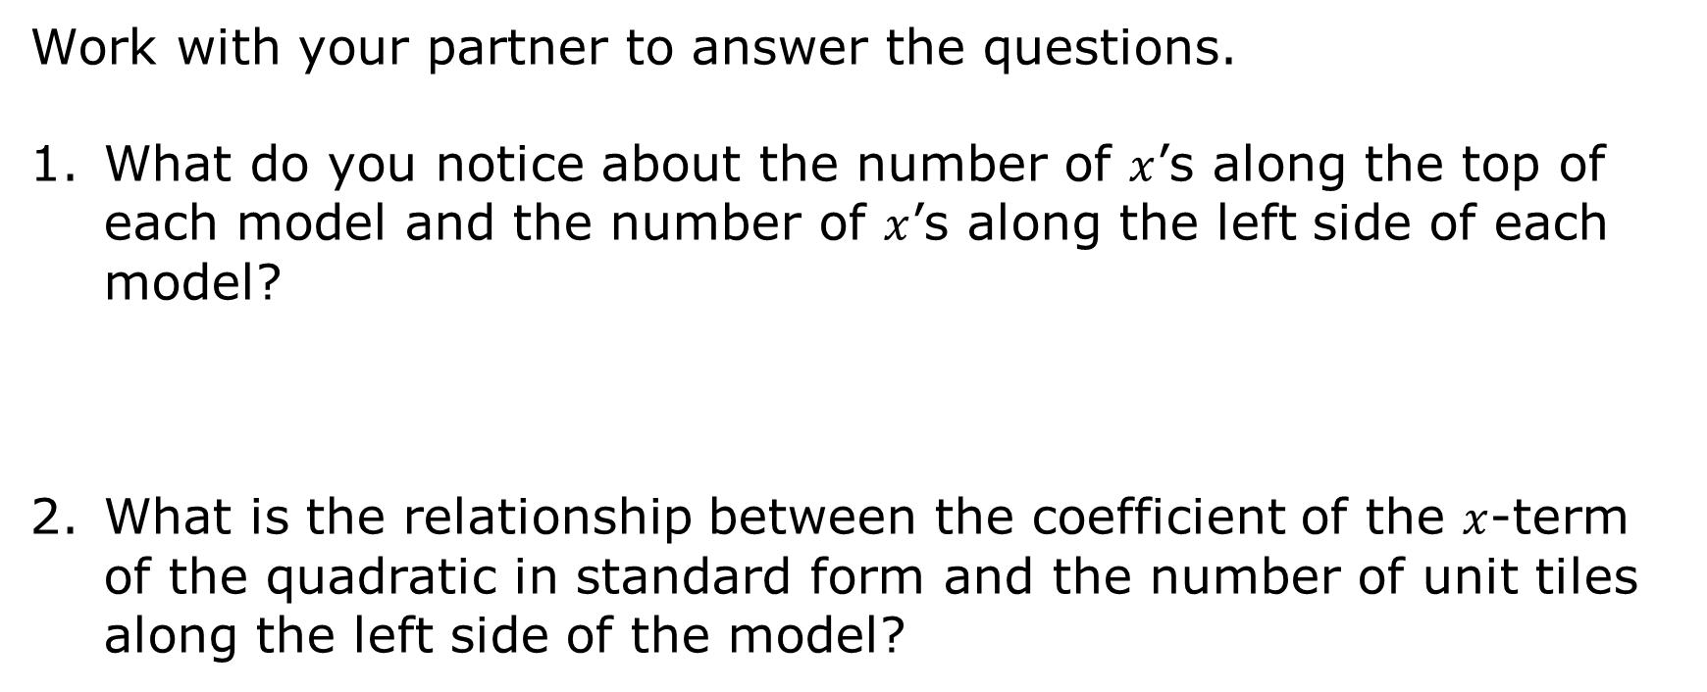
8.5.3 Collaboration: Conjectures About Completing the Square
Work with your partner to answer the questions.
What do you notice about the number of $x$’s along the top of each model and the number of $x$’s along the left side of each model?
What is the relationship between the coefficient of the $x$-term of the quadratic in standard form and the number of unit tiles along the left side of the model?
volume 2, pg. 36

Slide 21

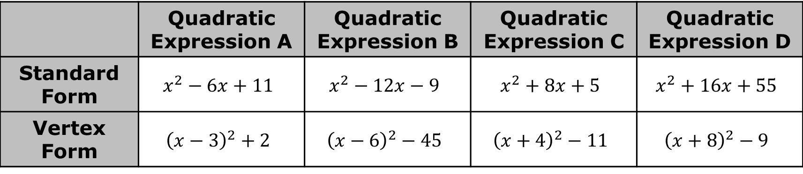
The table shows the four quadratic expressions from the Exploration.
Make a conjecture about how $b$, the coefficient of the $x$-term, of the quadratic expression in standard form,$x^{2}+bx+c,$ is related to the $h$-value of the equivalent quadratic expression in vertex form, ${\left(x−h\right)}^{2}+k$.
Make a conjecture on how to determine the $k$-value in vertex form of a quadratic expression from standard form.
 | Quadratic Expression A | Quadratic Expression B | Quadratic Expression C | Quadratic Expression D
Standard Form | $$x^{2}−6x+11$$ | $$x^{2}−12x−9$$ | $$x^{2}+8x+5$$ | $$x^{2}+16x+55$$
Vertex Form | $${\left(x−3\right)}^{2}+2$$ | $${\left(x−6\right)}^{2}−45$$ | $${\left(x+4\right)}^{2}−11$$ | $${\left(x+8\right)}^{2}−9$$
volume 2, pg. 36

Slide 22
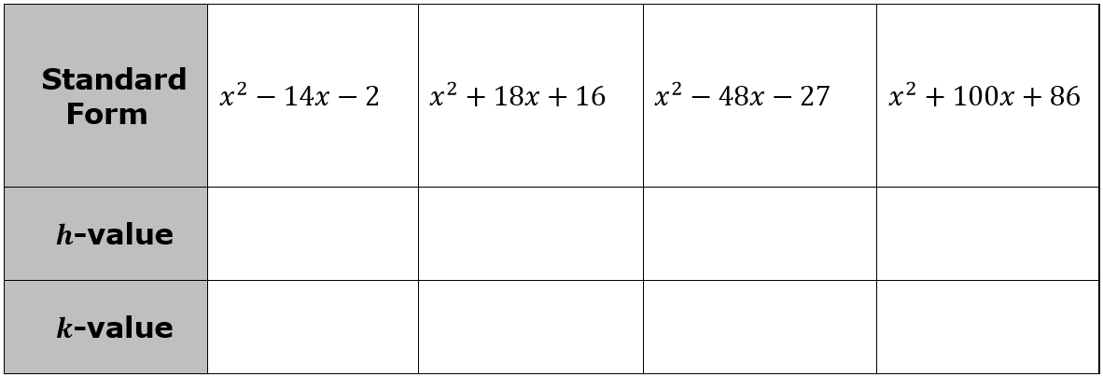

Use your conjectures to determine both the $h$-value and $k$-value of the quadratic in vertex form ${\left(x−h\right)}^{2}+k$.
Review your conjectures about completing the square with a different partner. Work through any differences and revise the conjectures and answers as necessary.
Verify any revisions with your original partner.
volume 2, pg. 37

Slide 23

Wrap-Up
volume 2, pg. 37

Slide 24
8.5.4 Wrap-Up: Cool Down
Complete the table.
The terms used in the Exploration that I knew were … | Something I wondered during the Exploration was … | Something I learned during the Exploration was …
volume 2, pg. 37

Slide 25
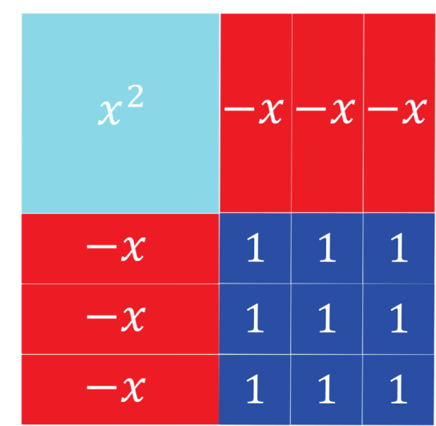
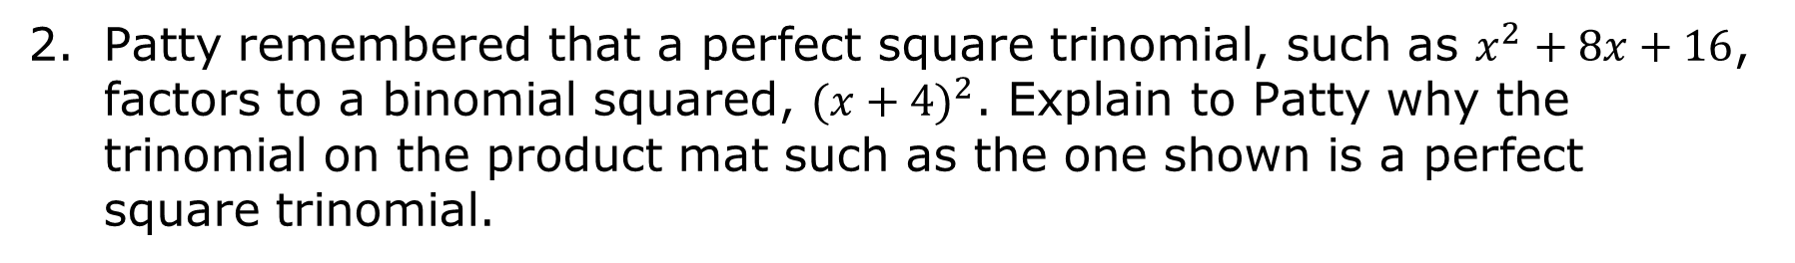
Patty remembered that a perfect square trinomial, such as $x^{2}+8x+16$, factors to a binomial squared, ${(x+4)}^{2}$. Explain to Patty why the trinomial on the product mat such as the one shown is a perfect square trinomial.
volume 2, pg. 37

